Slide 1
Spotify Clone From Scratch
By: Alex Zorola

Slide 2
Tools & Languages used
XAMPP (X: cross-platform + Apache + MySQL + PHP + Perl)
XAMPP all around package that comes with Apache HTTP Server, MariaDB (Now replaced by MySQL) database, and interpreters for scripts written in the PHP and Perl programming languages.
PHP
PHP: Hypertext Preprocessor) A scripting language that is widely used to create dynamic Web pages. Works great with MySQL database.
Javascript &JQuery
A programming language commonly used in web development. A client-side scripting language, which means the source code is processed by the client’s web browser rather than on the web server.
JQuery is a JavaScript library designed to simplify HTML DOM tree traversal and manipulation, as well as event handling, CSS animation, and Ajax.
MySQL
Is an Oracle-backed open source relational database management system based on Structured Query Language (SQL). MySQL runs on virtually all platforms, including Linux, UNIX, and Windows. Most associated with web applications and online publishing.

Slide 3
Demo

Slide 4

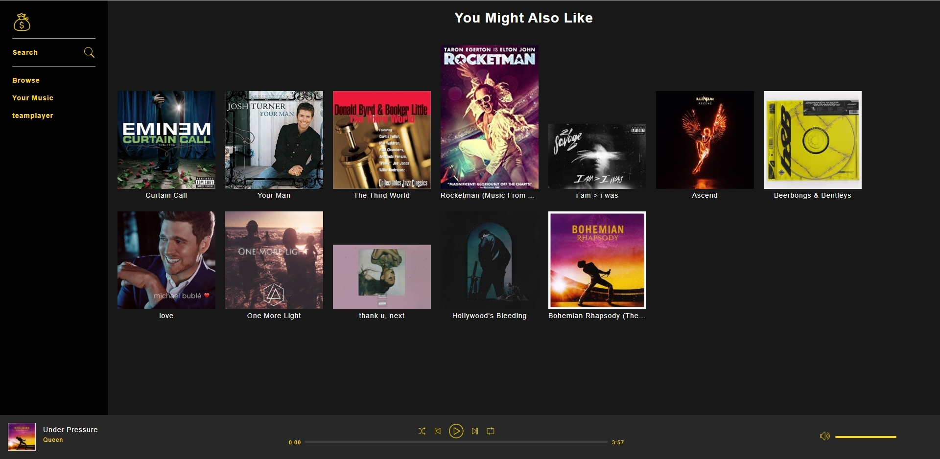
Structure of the page
3 Main Containers
NavigationBar Container
Inside the header file, because it will appear on every page
Making this a static element
NowPlayingBarContainer
Inside the footer file, because it will appear on every page
Making this a static element
Browse Container
Changes based on what page you are on so it will not be used as a static file but instead as a dynamic element

Slide 5
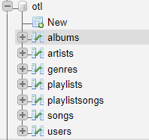
Structure of the database
Id | Title | Artists | Genre | artworkPath
Id | Name
Id | Name
Id | Name | Owner | dateCreated
Id | SongId | playlistId | playlistOrder
Id | Title | Artist | Album | Genre | Duration | Path | albumOrder | plays
Id | username | FirstName | LastName | Email | Password | signUpDate | ProfilePic

Slide 6
features
Login & Register
Password Encryption
Playing Bar Section
Album image, Album name & Artist Name redirect to their respective pages
Shuffle Playlist Functionality
Previous Song Functionality
Play and Pause Functionality
Next Song Functionality
Repeat Song Functionality
Song Progression Functionality
Volume Adjustment Functionality
Navigation Section
Home Button (Redirects to Browse)
Search Functionality
Browse Functionality
User Library Containing Playlists
User Section with Email and Password Changing Functionality

Slide 7
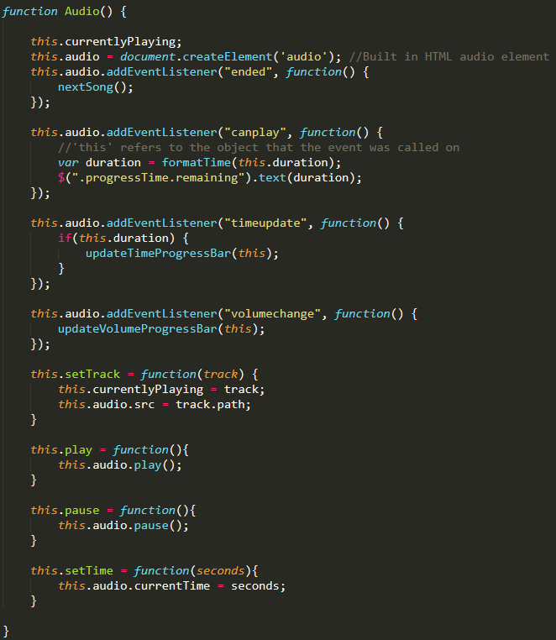
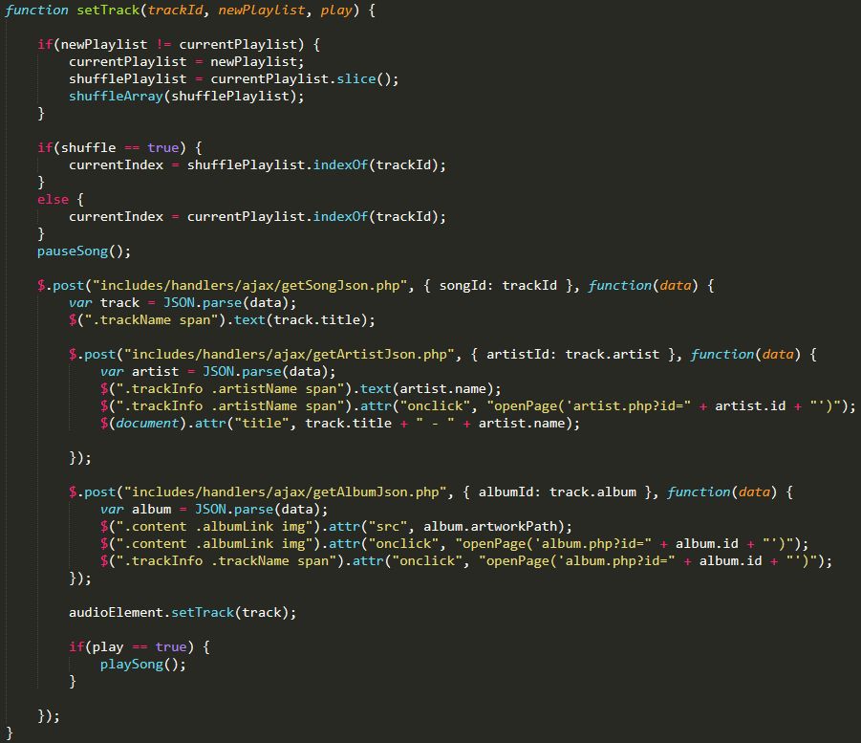
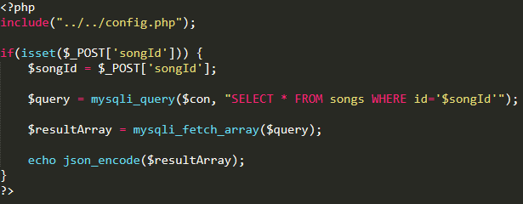
Set Track
This.audio is a built in HTML audio element that comes with a lot of attributes some being the play and pause functionalities.
Within the class we want to create the setTrack function for being able to set the current song that is playing and also set the path of the track to be the path resulting from the ajax calls.
Now within a script tag in the nowPlayingBar.php file we have the function setTrack it takes in the Id of the track or song, a newPlaylist, play (essentially a Boolean)
Through ajax calls within the setTrack function in the nowPlayingBar.php file you retrieve the data from the database, since the songs table contains Id’s for the album and artists your ajax calls for retrieving that data must be within the success function of the song ajax call.

Slide 8
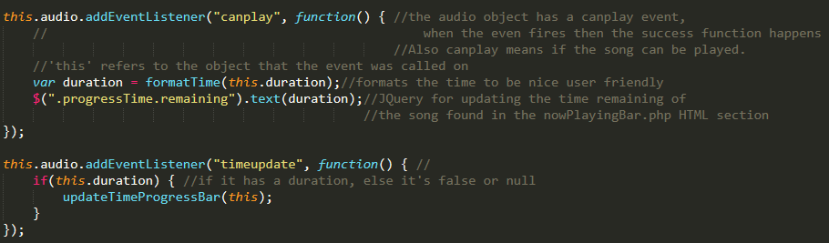
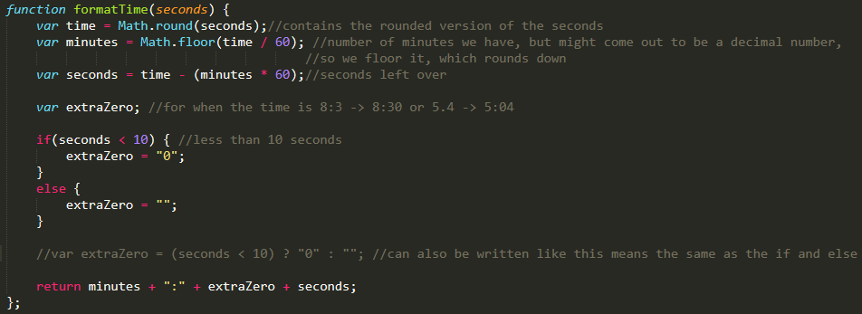
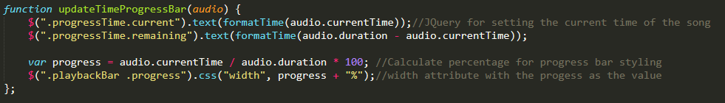
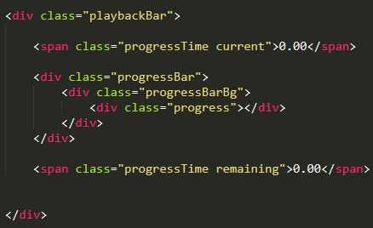
Song progression
The first step is to create an event listener called “canplay”, which essentially is checking to see if the song can be played.
Then taking the duration of the song and formatting it to be nice and user friendly.
Then you use JQuery to change the text to be actual duration of the song.
Within the script.js create a function which will handle all the formatting to be minutes and seconds instead of just seconds, which we had before.
Now the updateTimeProgressBar function handles the updating of the current time of the song playing. Essentially making the time count upwards as the song plays. Similarly making the song count down for the total duration in order to know how much time is remaining in the song.

Slide 9
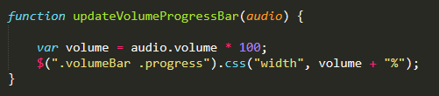

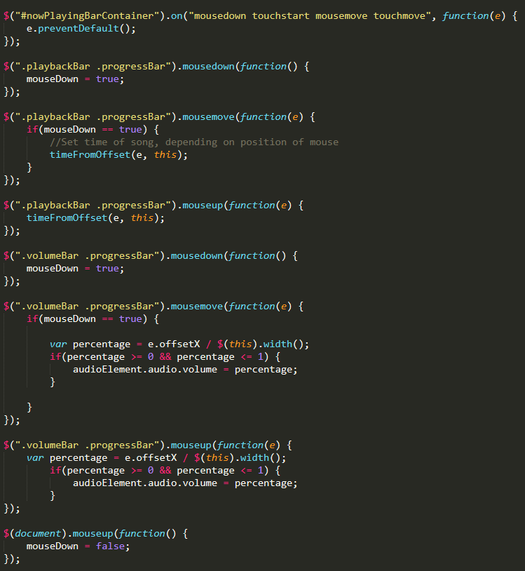
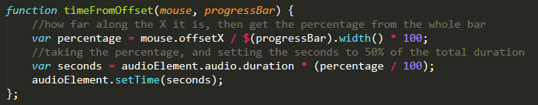
Song bar & volume control
For the song progress bar you want to be able to know when the user is clicking within the bar to change the position of the song.
Therefore using JQuery we can determine whether the mouse is down, being moved or let go.
On that instance we have to calculate the percent at which the user let go regarding the total width of the bar, then calculate the amount of seconds that percentage is in relation to the duration of the song.
We do just about the same for the volume bar. We add an event listener, that calls a function the calculates the percentage for the volume bar and sets the css for it.
Within the mousemove and mouseup is where we set the percentage if its greater than equal to 0 && less than or equal to 1. This fixes an error we get when the user moves it outside of the range.

Slide 10
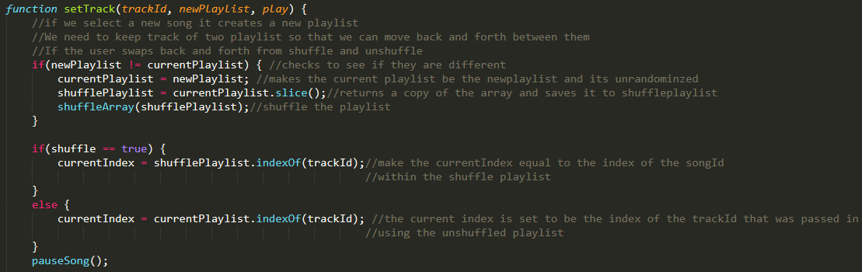
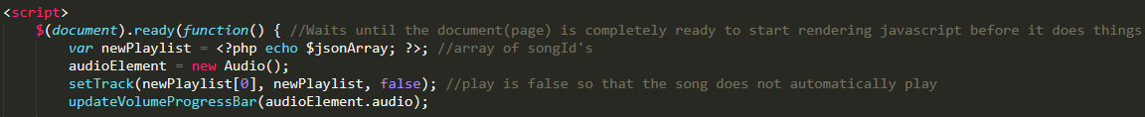
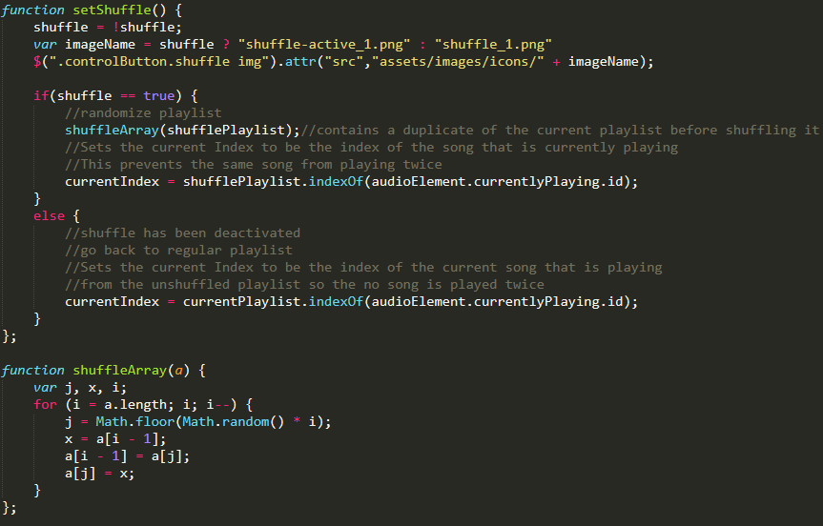
Shuffle playlist
Within script.js file make a variable called shuffle and default it to false.
Create a function that handles setting up the button.
Create a function that handles the logic behind shuffling an array.
We need to keep track of two arrays, one that contains the shuffled playlist and one that contains the unshuffled playlist.
Create an array in script.js and set it to an empty array.
SetTrack only gives a value to the shuffle playlist if the current playlist is different to the playlist that was passed in. When the page first loads currentplaylist will have no value, so newPlaylist and currentPlaylist will be different allowing setTrack to work.
Current Index being set so the same song does not play twice.

Slide 11
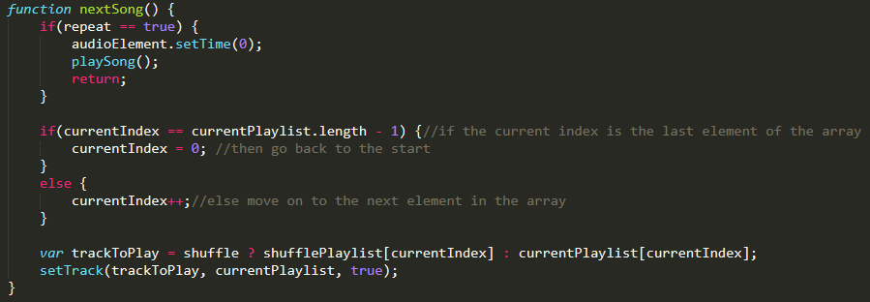

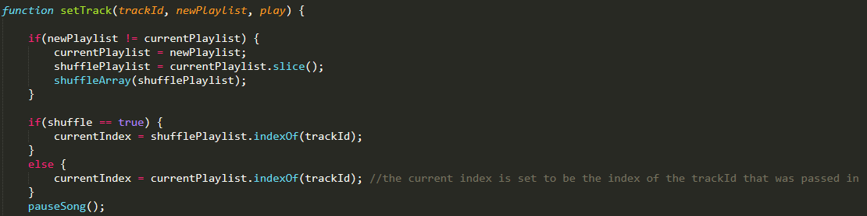
Next song
Within script.js we create a variable that will keep track of the currentIndex within the array of songs of the current songId being played.
0 : “2”
1 : “54”
2 : “15”
Then we check to see if the currentIndex is the last element in the array or not, if it is go to the first if not go to the next element.
We then pass that song into the setTrack function we created earlier and have the song play.
Lastly hook the function onto the button so it is called every time the button is pressed.

Slide 12
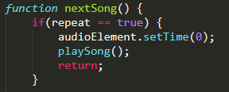


Repeat song
Within the script.js function we make a variable called repeat and set it to false.
In the next song function you just check to see if repeat is true then simply set the time of the song back to zero and continue playing the song.
We need to be able to switch repeat from false to true and vise versa.
Then we just hook it onto the button and the repeat variable will change based on if the repeat button is on or not.
On = True
Off = False

Slide 13
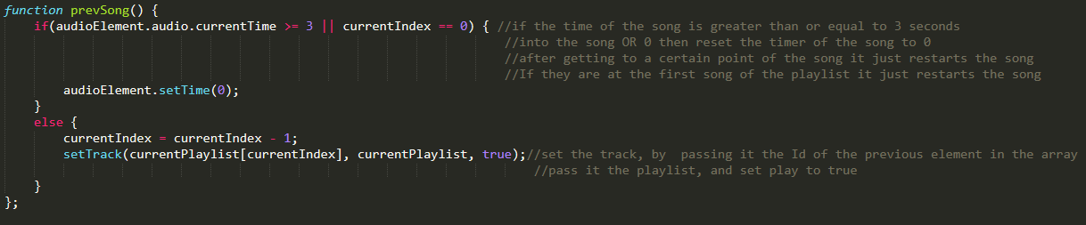
Previous Song
Within the nowPlayingBar.php file we create a function that handles the prevSong functionality.
First we check to see if the time passed for the current song is either greater than or equal to 3 seconds OR if the song is the first song in the playlist.
If one or the other is true then just restart the song.
Else go back to the previous element in the array of songs and pass the Id of that song into the setTrack function along with the playlist and set play to be true.
Lastly hook the function onto the button with the onclick attribute.

Slide 14
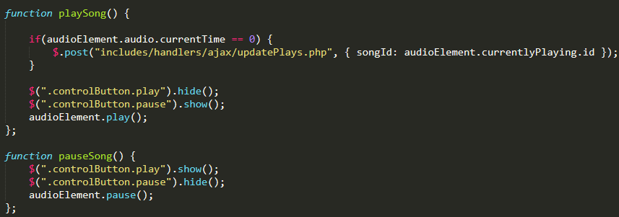
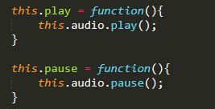
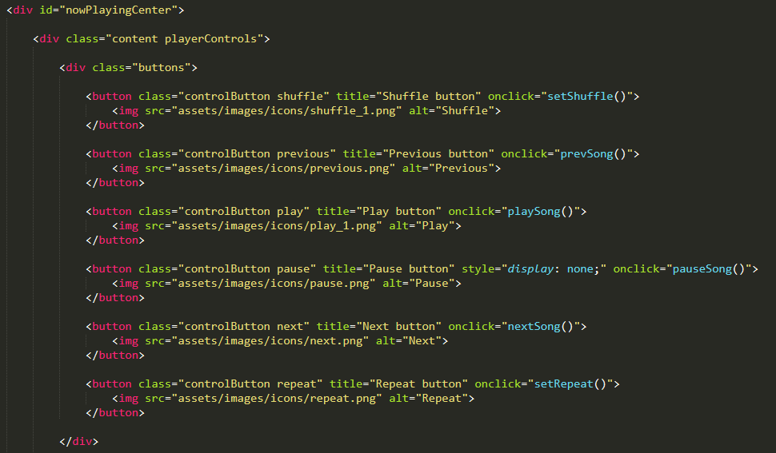
Play and Pause
Within the Audio class created in the script.js file you declare two functions that set the play and pause functionalities that come from the built in HTML audio element, so that it can be used in other pages.
Within the nowPlayingBar.php file creating two more functions for playing the song and pausing the song respectively. This is so that you can call these functions within the HTML of the page (i.e the buttons).
You also want to add some JQuery to show and hide either button when the other button is pressed, while also applying the respective functionality.

Slide 15
Difficulties
Transferring Project form localhost to online web server
Able to make an account with the google could platform
Able to make an account with bitnami
Able to link both accounts together
Able to create a virtual machine that hosts the web server
Able to upload files to the server
Was not able to get my web server to talk to MySQL database through PHPMYADMIN
Error: 1045 (Essentially the user does not have permission to access the database, however when testing the connection, it would connect).
Editing Video
The best way to make a video with no editing experience is to have multiple takes until you get it right (15 to be exact…)
Entering data into the Database all at once is not a good idea…
Retrieving data from the database that contained accented characters would break the application.

Slide 16
Sources
https://www.yourdictionary.com/php
https://techterms.com/definition/javascript
https://searchoracle.techtarget.com/definition/MySQL
https://en.wikipedia.org/wiki/XAMPP
https://www.udemy.com/course/spotify-clone/
https://cloud.google.com/
https://google.bitnami.com/

